Slide 1

Seed Grant Information Webinar
2024

Slide 2

Housekeeping
Please keep yourself on mute
This meeting is being recorded
Closed captioning is available
Please add questions in the chat

Slide 3

Land Acknowledgment
We want to acknowledge that the land on which this meeting is being virtually held is the territory of the Mississaugas of the Credit First Nation, the Huron-Wendaat, the Haudenosaunee, the Anishinaabek, and the Attiwonderonk or Neutral peoples.
As we discuss our work and sector, and as a large, longstanding social service organization, it’s critical that we reflect on our past and present in order to strive towards inclusive, equitable, and resilient future. We continue to work towards equity and community impact together, with consideration for the many ways of knowing and being that exist on these lands.

Slide 4
Overview of Seed grant
Eligibility and ineligibility
Evaluation
Resources available on the website
Demonstration of Registration & application portal
Timeline and important dates
Q&A
Agenda

Slide 5
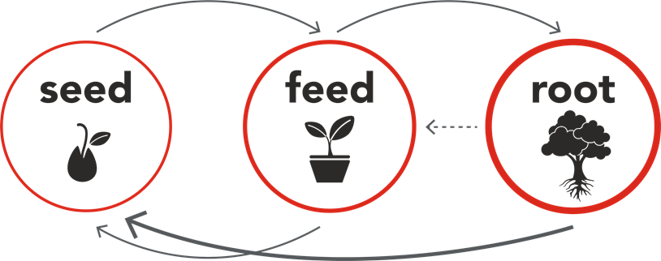
INVESTMENT FRAMEWORK
Notes:
Seed is our one year grant which fosters the planting of new ideas and growth in the social sector through short-term, flexible, project-based funding focused on social innovation and capacity building.
Feed is our three-year program-based funding for existing programs in community that utilize results-based accountability to measure the success of their program. Programs must fill a gap in community and align their program outcomes with UWHH Outcomes & Indicators.
Root is our five-year agency-based funding for organizations meeting additional criteria and seeking to strengthen their agency at the core. Root funding supports programming, as well as foundational operating needs.

Slide 6

“One-year, project-based funding for capacity building and/or innovation processes focused on amplifying impact and transformation that aligns with UWHH investment priorities.”

Slide 7
Definitions
Innovation
Capacity Building
Social innovation refers to the design and implementation of new solutions that imply conceptual, process, product, or organizational change, which ultimately aim to improve the welfare and wellbeing of individuals and communities.
Organization for Economic Co-Operation and Development
Capacity-building is defined as the process of developing and strengthening the skills, instincts, abilities, processes and resources that organizations and communities need to survive, adapt, and thrive in a fast-changing world.
United Nations

Slide 8
Definitions
Innovation
Capacity Building
A new way of doing, thinking, or communicating
  Design thinking or co-design
  Piloting a new program model
  Exploring new idea through research
  Collaborating with an organizational partner on a new project
A way to increase action, understanding, or impact
  Hiring a consultant
  Conducting an organizational audit
  Re-tooling programs by investing in new software
  Purchasing an organizational subscription to a resource library and coaching system

Slide 9
eligibility
ELIGIBLE
Incorporation
  Registered Chairty
  Non-Qualified Donee with Fiscal Sponsor
Geography
  Halton
  Hamilton
UWHH Investment Alignment
  Poverty to Possibility
  All That Kids Can be
  Healthy People Strong Communities
Misc. Elements
  Limit of one project/agency
  Max limit of $75,000/agency
  Agencies receiving other UW funding
INELIGIBLE
Government Entities
  Federal/Provincial/Territorial Entities
  School boards and Universities
Political and Faith based institutes
  Political or faith-based organizations that are in adherence to or promotion of religious or political views and affiliations
Strictly arts/heritage/environmental agency
Individuals and For-Profit Institutions
  Business nonprofit institutions – Associations, Chamber of Commerce etc.
  Condominium associations, Sub granting nonprofits

Slide 10
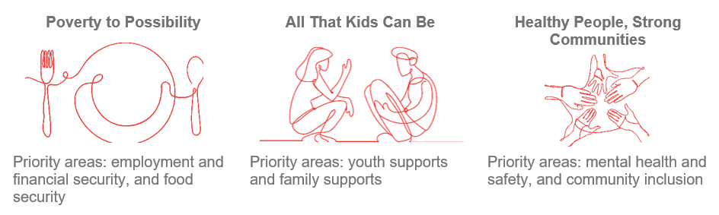
Focus Areas
Notes:
Agencies work must align with one or more of our focus area and investment priorities
Though the project you're applying for may not be client-facing, agencies work overall must still align & support people in Halton and Hamilton

Slide 11
Expenses
Eligible
Staffing (new or existing)
Consultant/service provider
Supplies/materials/equipment (including digital)
Rental costs
Participant supports/honorariums (e.g. travel, childcare)
Ineligible
Expenses incurred prior to initiative start date
Capital/asset acquisition/real estate fees/other related costs
Legal penalties
Deficit funding or debt reduction funding
Notes:
For a more fulsome list view Seed Guide (includes a list of potential activities that would be applicable as well)

Slide 12
PROCESS Overview
Application coaching (optional – 30 min)
Registration
Application
UWHH Evaluation
  Impact Cabinet review & Board approval
Agency Notification

Slide 13
Evaluation Criteria
Organizational
Diversity Equity and Inclusion
Governance & Financial Accountability
Potential impact of the proposed program
  Relation to agency mission & client support
Feasibility (budget & implementation plan)

Slide 14
Available Resources
Seed Grant Overview Guide
Seed Grant Application Sample
Community Investment Framework document
Online Application Guideline
Application Coaching Support (30 min slots)
Recording of Webinar
Notes:
Recording of webinar will be shared out to those who registered
Will also be made available online along with the Application Guide

Slide 15
Registration & Application Process
Register online at uwhh.ca under Investments -> Seed
  Agency Info
  Mission Statement
  CRA charitable registration number
  Contact Info
  Project Info
Approved: We will send you a link to proceed with the application
Declined: We will send you an email with the rationale
  Response within 3 business days
  Add us to your safe sender list so you don't miss out on emails
Notes:
Registration is mainly to screen agencies for eligibility and alignment with the focus of the Seed grant
If declined, agencies will not be invited to fill out the full application but will be given rationale for the decline
If accepted, agencies will be emailed a link to access the application
*Do not lose the application invitation email – it will contain a unique link for your agency only! (There is no user name or password needed)

Slide 16

APPLICATION DEMONSTRATION
Notes:
Main contact if you have questions or issues is our Community Investment inbox: communityinvestment@uwhh.ca

Slide 17

Timeline & Important Dates
Registration & Application Open: June 3
Application Coaching: June 3 - 24
Application Closes: July 8
CIC Review & Board Approval: July - September
Notification to Grantees: End of September
Initiatives End: Nov - Dec 2025
Initiatives Start: Oct - Dec 2024
Mid-Grant Check In: May 2025
Notes:
Both the registration and application open June 3.
If agencies register on June 3, we will do our best to review ASAP and if ‘accepted’ agency will be emailed link to fill out the full application online.
Flexible start and end dates to give agencies time to hire/work with external partners/relationship build.
Flexible end date as project scopes may range. They can end sooner than this date.

